Slide 1
CS 252 Database Management Systems
Jan – May 2020
IV Semester
* Use the slides for reference only. Refer the text book for details.

Slide 2
Weak Entity Types
An entity that does not have a key attribute and that is identification-dependent on another entity type.
A weak entity must participate in an identifying relationship type with an owner or identifying entity type
Entities are identified by the combination of:
A partial key of the weak entity type
The particular entity they are related to in the identifying relationship type
Example:
A DEPENDENT entity is identified by the dependent’s first name, and the specific EMPLOYEE with whom the dependent is related
Name of DEPENDENT is the partial key
DEPENDENT is a weak entity type
EMPLOYEE is its identifying entity type via the identifying relationship type DEPENDENT_OF

Slide 3
Attributes of Relationship types
A relationship type can have attributes:
For example, HoursPerWeek of WORKS_ON
Its value for each relationship instance describes the number of hours per week that an EMPLOYEE works on a PROJECT.
A value of HoursPerWeek depends on a particular (employee, project) combination
Most relationship attributes are used with M:N relationships
In 1:N relationships, they can be transferred to the entity type on the N-side of the relationship

Slide 4
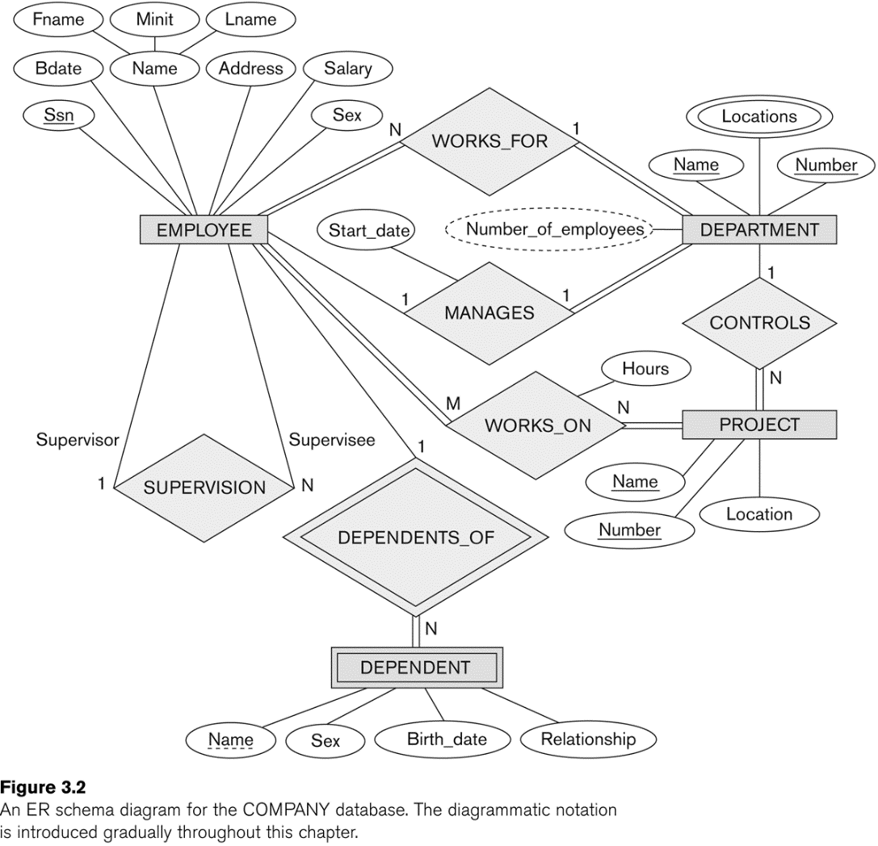
Example of an Attribute of a Relationship Type

Slide 5
Notation for Constraints on Relationships
Cardinality ratio (of a binary relationship): 1:1, 1:N, N:1, or M:N
Shown by placing appropriate numbers on the relationship edges.
Participation constraint (on each participating entity type): total (called existence dependency) or partial.
Total shown by double line, partial by single line.
NOTE: These are easy to specify for Binary Relationship Types.

Slide 6
Alternative (min, max) notation for relationship structural constraints:
Specified on each participation of an entity type E in a relationship type R
Specifies that each entity e in E participates in at least min and at most max relationship instances in R
Default(no constraint): min=0, max=n (signifying no limit)
Must have min≤max, min≥0, max ≥1
Derived from the knowledge of mini-world constraints
Examples:
A department has exactly one manager and an employee can manage at most one department.
Specify (0,1) for participation of EMPLOYEE in MANAGES
Specify (1,1) for participation of DEPARTMENT in MANAGES
An employee can work for exactly one department but a department can have any number of employees.
Specify (1,1) for participation of EMPLOYEE in WORKS_FOR
Specify (0,n) for participation of DEPARTMENT in WORKS_FOR

Slide 7
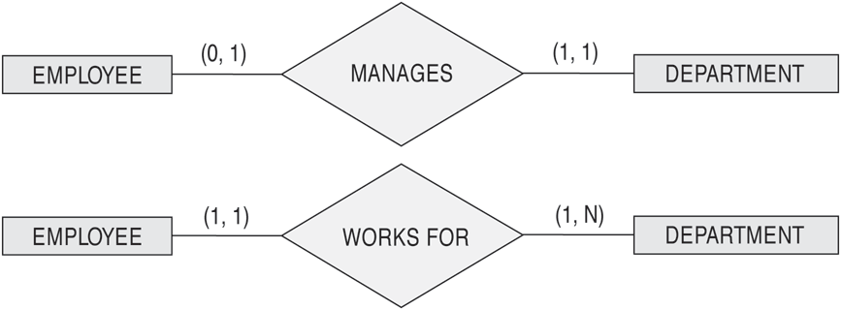
The (min,max) notation for relationship constraints
Read the min,max numbers next to the entity type and looking away from the entity type

Slide 8
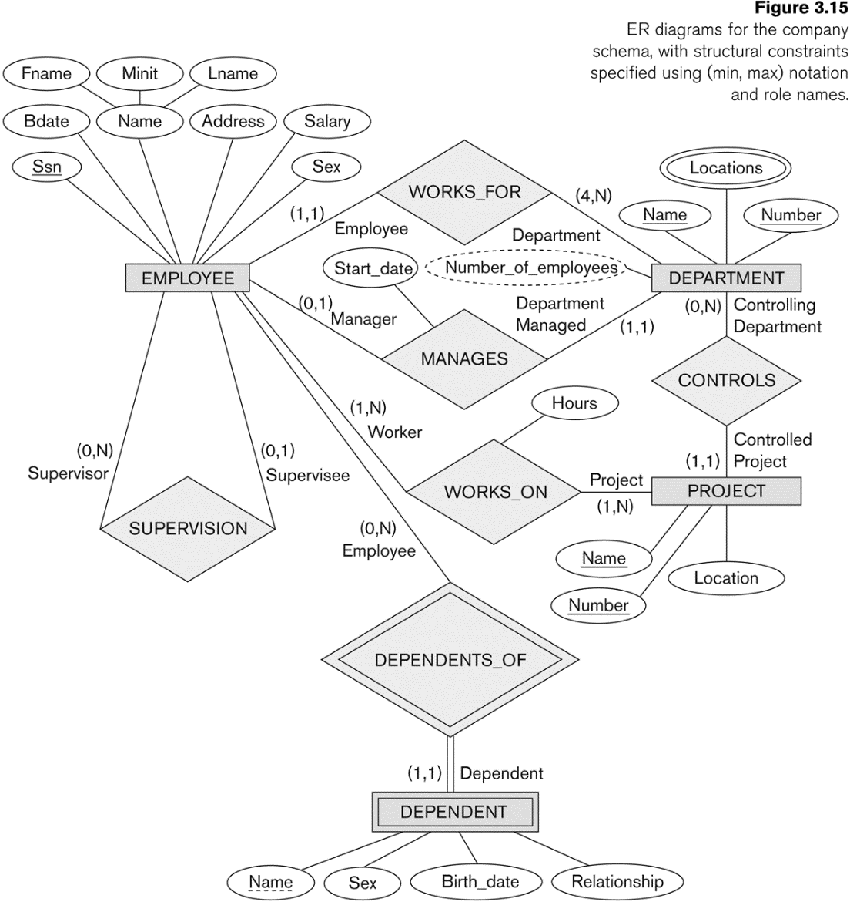
COMPANY ER Schema Diagram using (min, max) notation

Slide 9
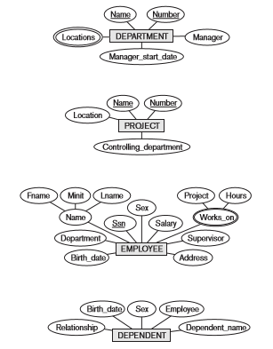
Refining the ER Design of COMPANY Database

Slide 10
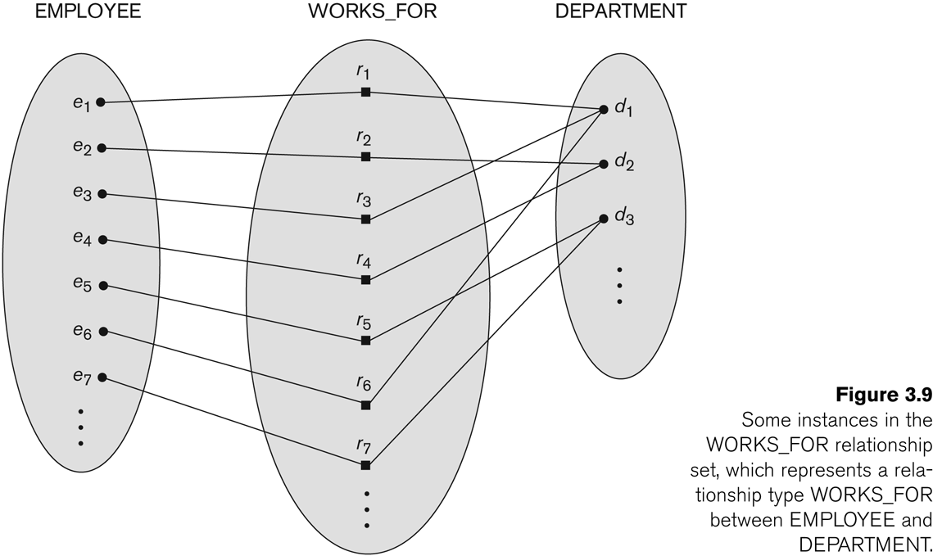
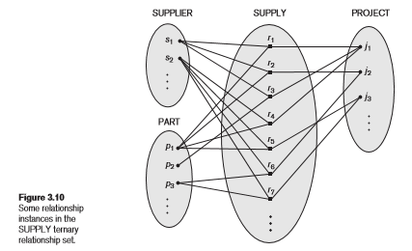
Degree of a Relationship Type
Degree = 2 (binary)
Degree = 3 (ternary)

Slide 11
Relationships of Higher Degree
Relationship types of degree n are called n-ary
In general, an n-ary relationship is not equivalent to n binary relationships
Constraints are harder to specify for higher-degree relationships (n > 2) than for binary relationships

Slide 12
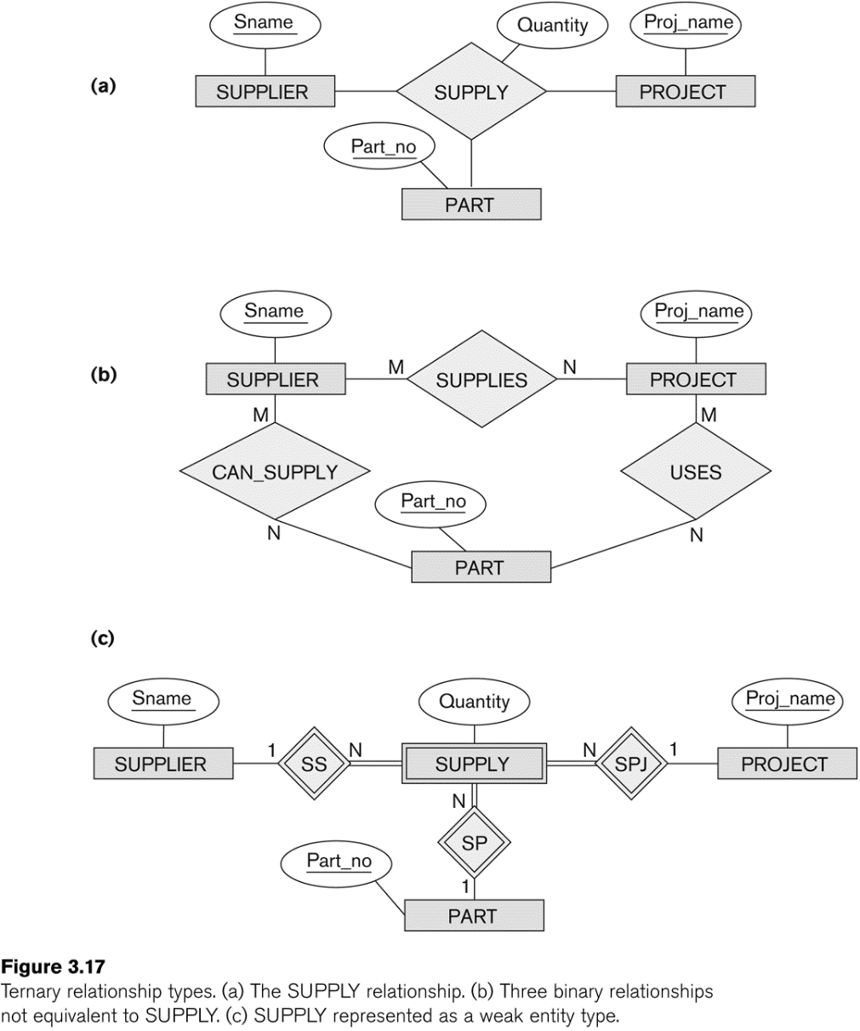
Example of a ternary relationship

Slide 13
Discussion of n-ary relationships (n > 2)
In general, 3 binary relationships can represent different information than a single ternary relationship (see Figure a and b on previous slide)
If needed, the binary and n-ary relationships can all be included in the schema design (see Figure a and b on previous slide, where all relationships convey different meanings)
In some cases, a ternary relationship can be represented as a weak entity if the data model allows a weak entity type to have multiple identifying relationships (and hence multiple owner entity types) (see Figure c on previous slide)
If a particular binary relationship can be derived from a higher-degree relationship at all times, then it is redundant

Slide 14
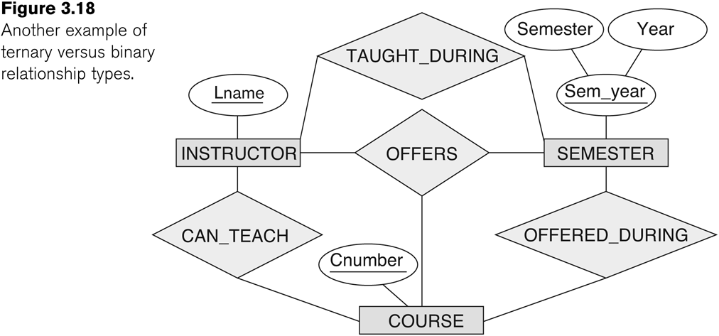
Another example of a ternary relationship

Slide 15
Displaying constraints on higher-degree relationships
The (min, max) constraints can be displayed on the edges – however, they do not fully describe the constraints
Displaying a 1, M, or N indicates additional constraints
An M or N indicates no constraint
A 1 indicates that an entity can participate in at most one relationship instance that has a particular combination of the other participating entities
In general, both (min, max) and 1, M, or N are needed to describe fully the constraints
Overall, the constraint specification is difficult and possibly ambiguous when we consider relationships of a degree higher than two.

